Slide 1


Railway Reservation System
Submitted By: Ujjwal
ID: AF0405137

Slide 2

Outline of Presentation
Introduction
Objective
Literature Review
Methodology
Hardware /Software Requirement
Experimentation
Result
Conclusion
Technology Used

Slide 3
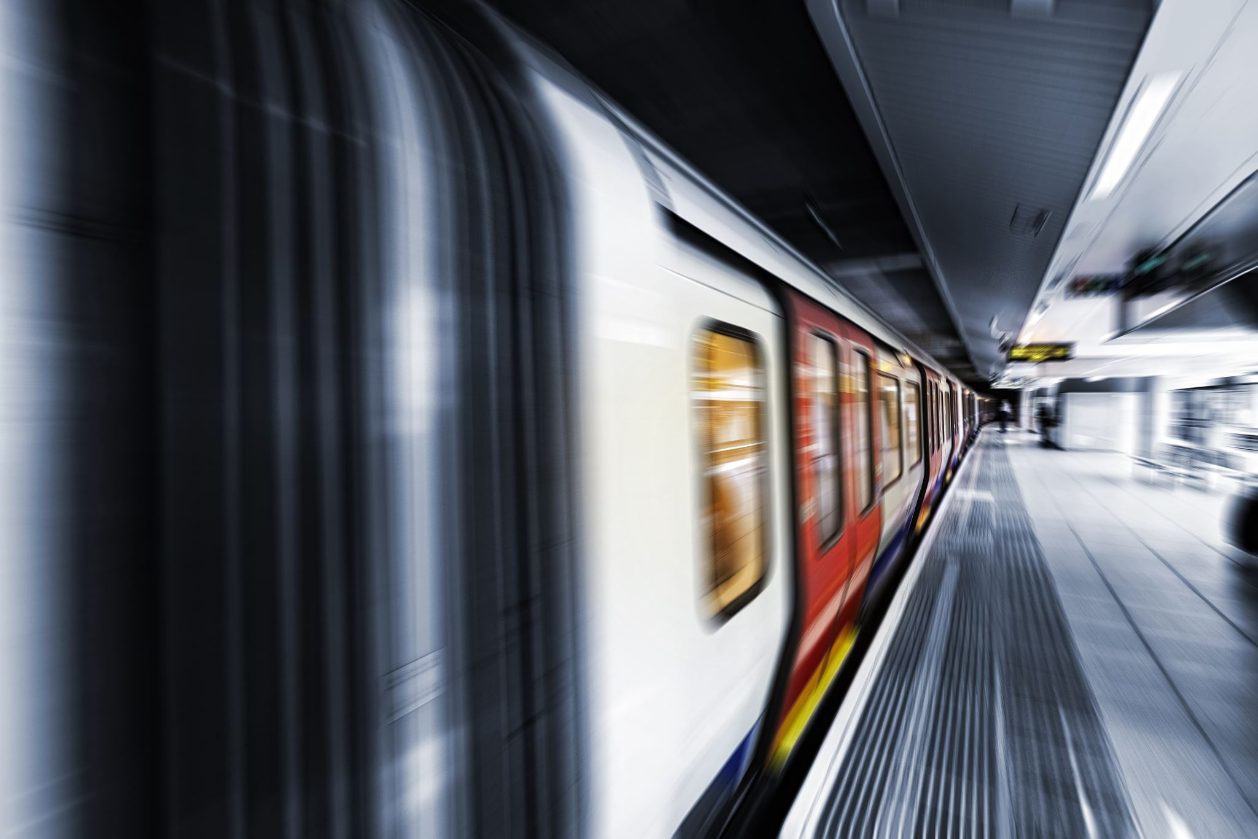
Introduction
The Railway Reservation System (RRS) is a vital component in modernizing railway operations, aiming to streamline ticket booking processes, optimize resource utilization, and enhance passenger experience.
As the demand for rail transportation continues to rise, efficient management becomes crucial for ensuring smooth operations and customer satisfaction.
The RRS serves as a centralized platform that facilitates ticket reservations, train scheduling, and passenger information dissemination.

Slide 4
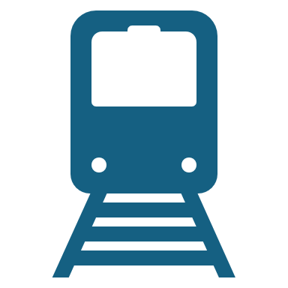
Objective
The primary objective of implementing the Railway Reservation System is to automate and simplify the ticket booking process for passengers while improving overall efficiency for railway operators. Specific objectives include:
Enhancing accessibility for passengers to book tickets through various channels.
Optimizing train scheduling to minimize delays and maximize resource utilization.
Providing information to passengers regarding train status, scheduled changes, and delays.
Improving revenue management through dynamic pricing strategies and promotions.
Enhancing security measures to ensure the safety of passengers and railway assets.

Slide 5
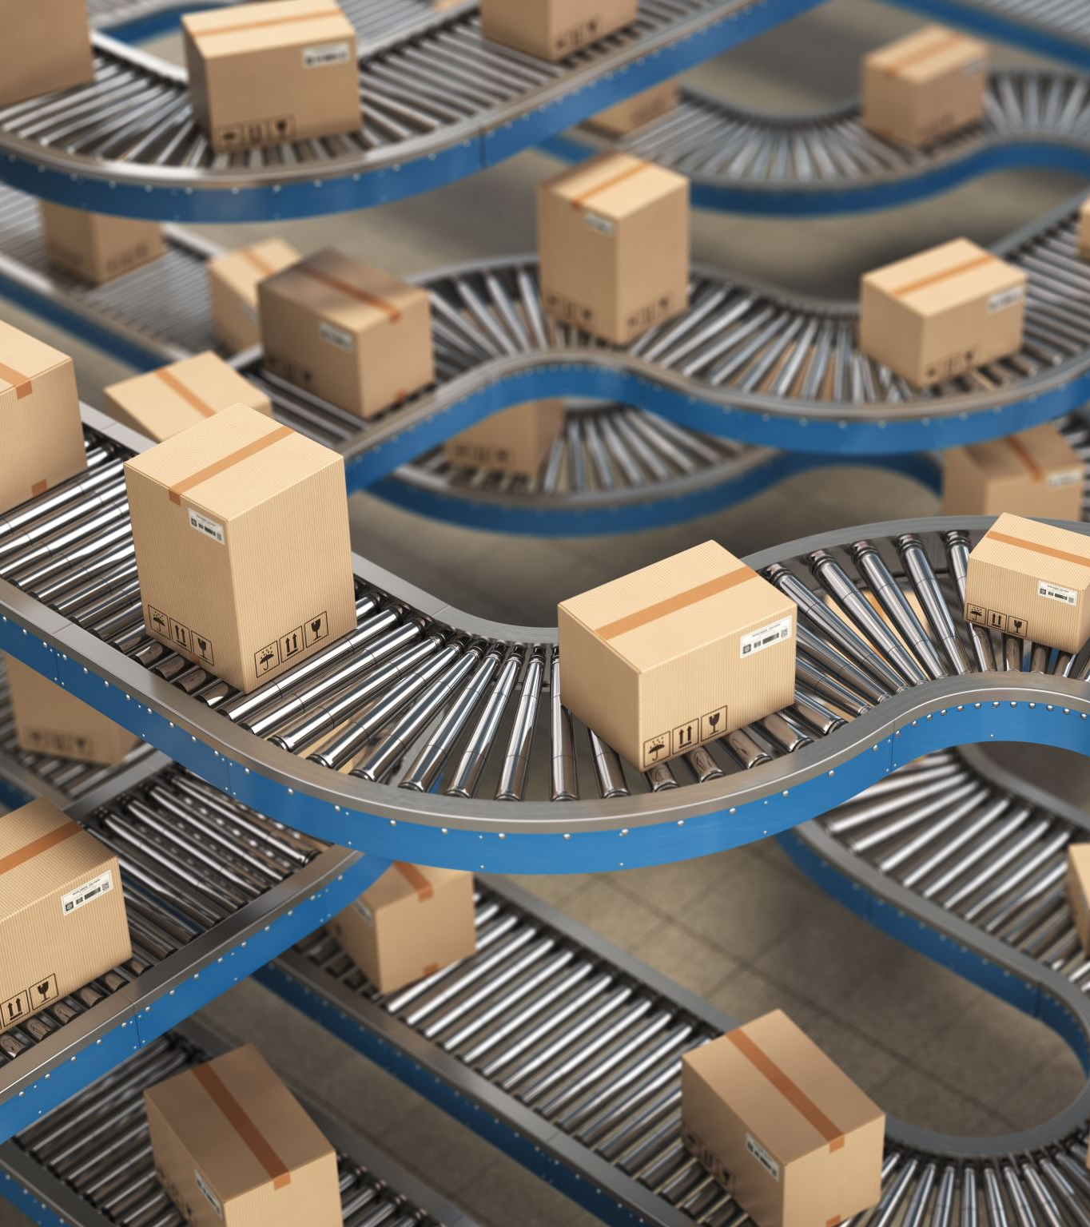
Literature Review
The impact of automated ticket booking systems on passenger satisfaction and convenience.
Strategies for optimizing train scheduling to minimize operational costs and improve resource allocation.
The role of information technology in modernizing railway management and enhancing safety measures.
Case studies highlighting successful implementations of railway reservation systems in different regions, demonstrating their benefits in improving service quality and operational performance.

Slide 6
Methodology
The development and implementation of the Railway Reservation System involve several stages, including:
Requirement Analysis: Understanding the needs of passengers and railway operators to determine system functionalities and features.
System Design: Designing the architecture, database structure, and user interfaces of the reservation system.
Development: Building the system components, including backend servers, databases, and frontend interfaces.
Testing: Conducting rigorous testing to ensure the reliability, security, and usability of the reservation system.
Deployment: Deploying the system across railway stations and online platforms, ensuring seamless integration with existing infrastructure.
Maintenance: Providing ongoing support and maintenance to address issues, implement updates, and enhance system capabilities.

Slide 7
Technology Used:
Java
JPA
Hibernate
MySQL

Slide 8
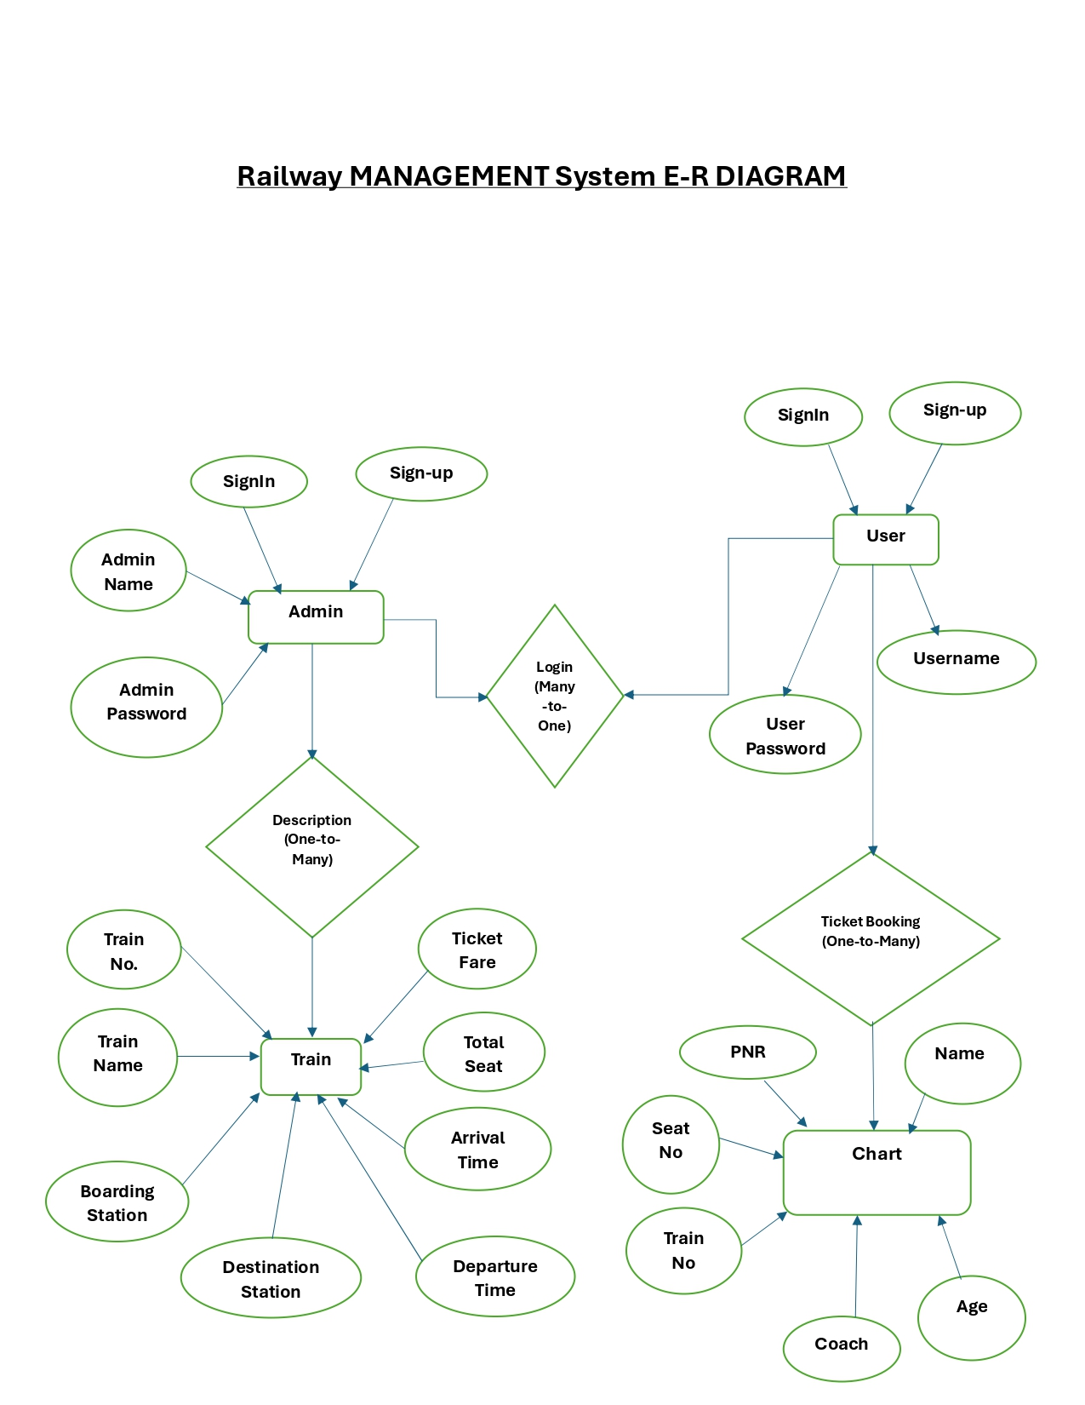
E-R Diagram:

Slide 9
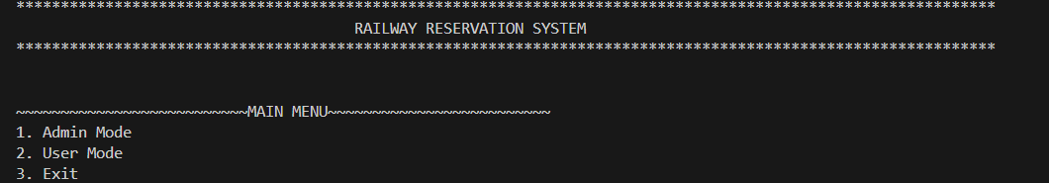
Railway Reservation System Main Menu:

Slide 10
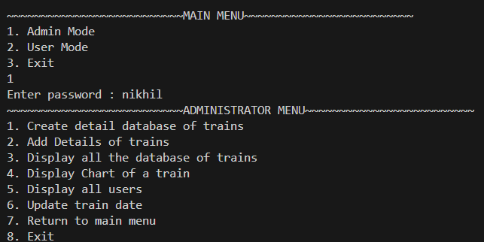
Admin Mode:

Slide 11
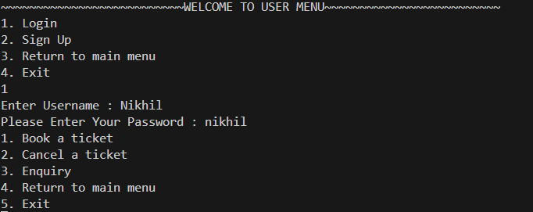
User Mode:

Slide 12
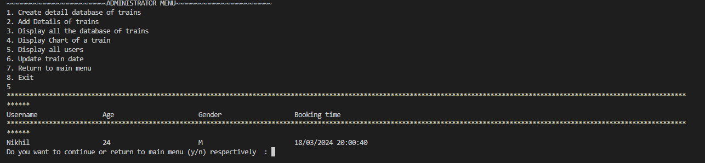
User Credentials:

Slide 13
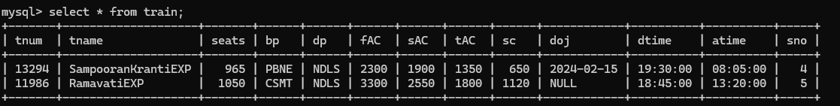
Train Details:

Slide 14

Hardware/Software Requirements:
The Railway Reservation System typically requires the following hardware and software components:
Hardware: Servers for hosting the reservation system, network infrastructure for communication, ticketing machines at railway stations.
Software: Database management systems, web servers, programming languages (e.g., Java), reservation system software (e.g., ticket booking applications, passenger information displays).

Slide 15
Experimentation:
Experimental evaluation of the Railway Reservation System involves testing various aspects such as system performance, user interface usability, and reliability. Key experiments may include:
Performance Testing: Assessing the system's response time, throughput, and scalability under different loads and usage scenarios.
Usability Testing: Conducting user testing sessions to evaluate the ease of use and intuitiveness of the reservation system's interface.
Security Testing: Identifying and mitigating potential security vulnerabilities, such as unauthorized access and data breaches.
Integration Testing: Verifying the compatibility and interoperability of the reservation system with existing railway infrastructure and third-party applications.

Slide 16
Result
The results of implementing the Railway Reservation System are expected to include:
Improved efficiency and accuracy in ticket booking processes, leading to reduced queuing times and increased customer satisfaction.
Enhanced train scheduling and resource utilization, resulting in fewer delays and optimized operational costs.
Better dissemination of real-time information to passengers, improving their travel experience and reducing frustration.
Increased revenue generation through dynamic pricing strategies and targeted promotions.
Strengthened security measures, ensuring the safety of passengers and railway assets.

Slide 17
Conclusion
In conclusion, the Railway Reservation System plays a crucial role in modernizing railway operations and improving service quality for passengers. By automating ticket booking processes, optimizing train scheduling, and enhancing passenger information dissemination, the system contributes to increased efficiency, revenue generation, and customer satisfaction. Moving forward, continuous evaluation and improvement of the reservation system are essential to address evolving needs and challenges in the railway industry.

